Slide 1
REPRESENTATIONS OF YOUTH: THE CASE OF INTOXICANTS AND INTOXICATION Geoffrey Hunt Nordic youth research symposium (nyris) “narrowing paths –transgressive routes” aarhus 14-16th August 2019

Slide 2
CONCERNS ABOUT YOUTH AND THE DEVELOPMENT OF YOUTH STUDIES

Slide 3
“the history of research on youth is both a history of ‘young people themselves . . . [and also] a history of adults’ preoccupations and panics’ (Griffin 1993).

Slide 5
1969 Youth and Society
1972 Journal of Youth and Adolescence
1978 Journal of Adolescence
1980 Journal of Adolescent Health
1982 Youth and Policy
1986 Journal of Adolescent Research
1987 International Journal of Adolescence and Youth
1991 Journal of Research on Adolescence

Slide 6
1993 Young
1998 Journal of Youth Studies
2001 Journal of Youth Justice;
2002 Journal of Youth and Theology
2003 Youth Violence and Juvenile Justice
2006 Journal of Youth Development
2008 Journal of LGBT Youth
2010 Youth Voice Journal &
International Journal of Child, Youth and Family Studies

Slide 7
YOUTH AND INTOXICATION/INTOXICANTS

Slide 8
“the goal of artificially inducing a change in one’s consciousness is considered by many to be immoral” (Howard Becker 1967)

Slide 11
Jock Young (1942-2013)

Slide 13
Representations of Youth: Social Science Approaches

Slide 14
1. DEVIANCY AND DELINQUENCY PERSPECTIVE

Slide 15
Robert E. park (1864-1944)

Slide 17
2. PUBLIC HEALTH AND EPIDEMIOLOGY PERSPECTIVE

Slide 18
2. Representations of Youth: The Authorities and the Media

Slide 19
DIFFERENTIATED YOUTH AND INTOXICANTS – ISSUES OF CLASS, ETHNICITY AND GENDER.

Slide 20
1st Example:
19th Century Working Class Youth in England

Slide 21
“THE HOOLIGAN”

Slide 23
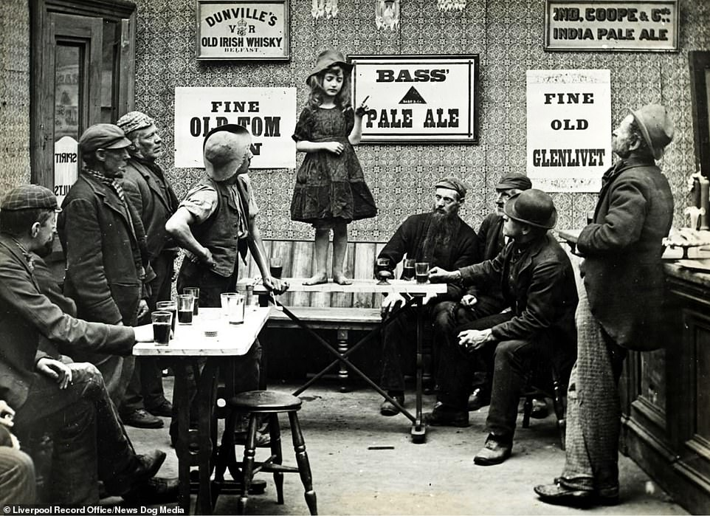

Slide 24
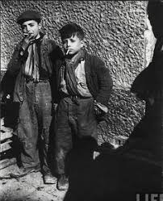
Boys smoking

Slide 25
2nd Example:
Drugs, Youth, Gangs and ethnicity in the US

Slide 26
“a scapegoated substance to a troubling subordinate group – including working-class immigrants, racial or ethnic minorities, or rebellious youth” (Reinarman and Levine 1997).

Slide 27
3rd Example:
Intoxicants, Gender and the Nighttime economy

Slide 28
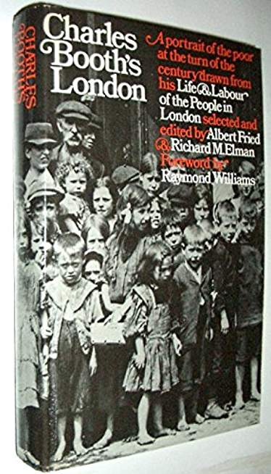
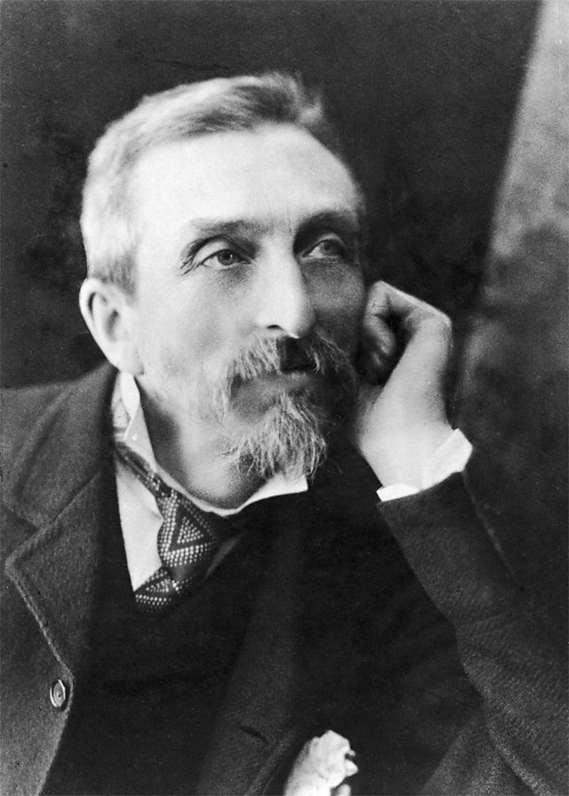
Charles Booth (1840-1916)

Slide 29
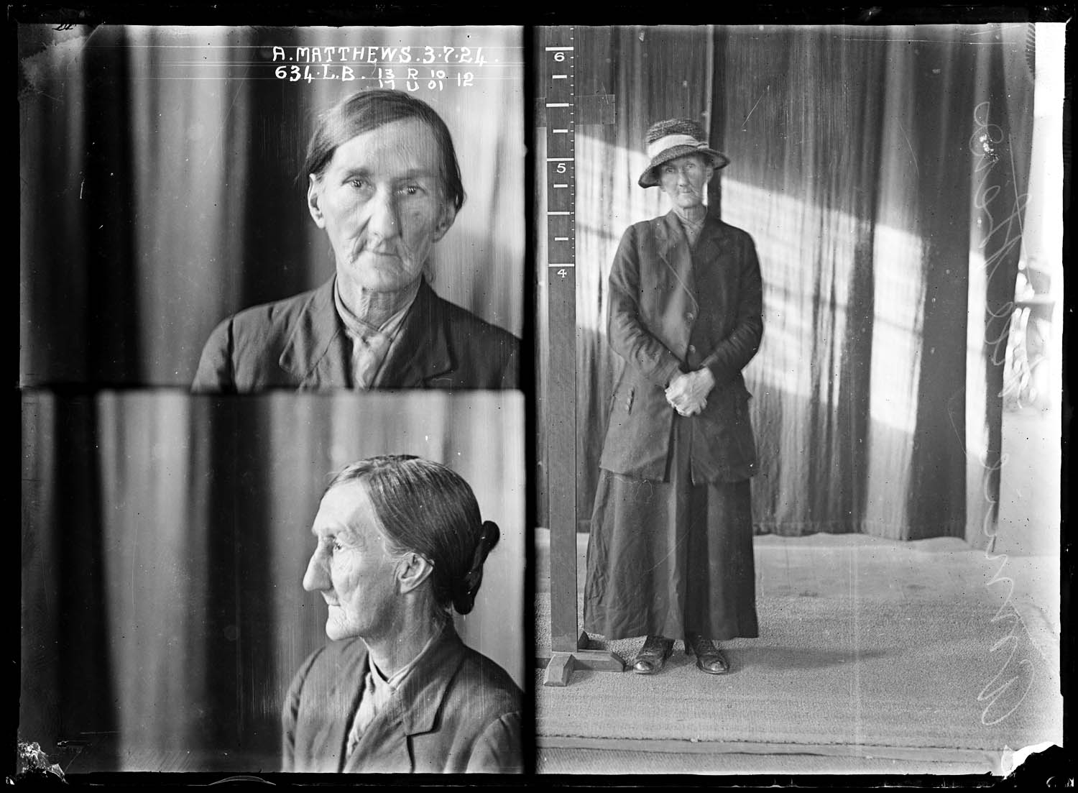
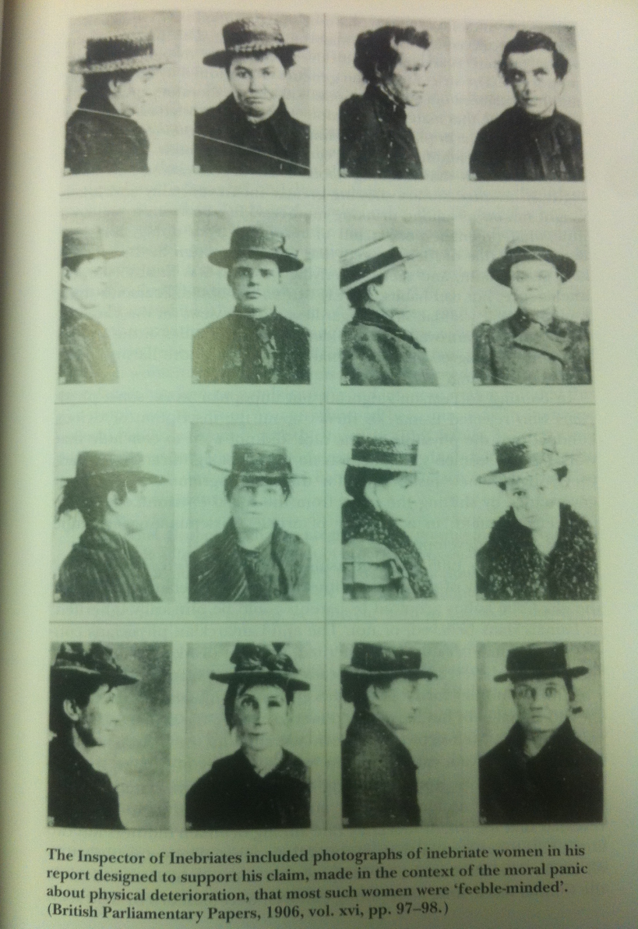
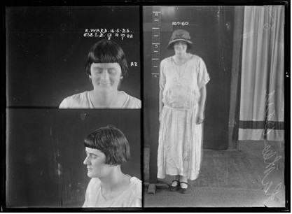
Inebriate Victorian Women

Slide 30
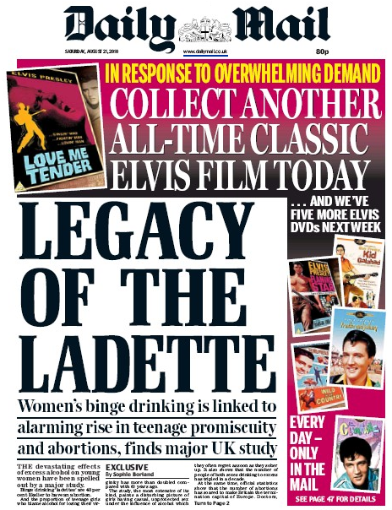
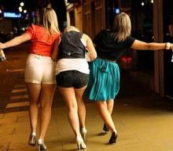
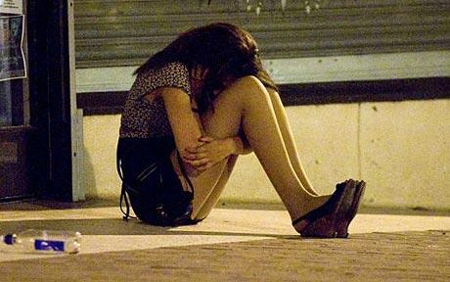
The Ladette Takeover

